Slide 1
Control Statements: Assignment, ++ and -- Operators
BY VICTOR MAJALATA

Slide 2
OBJECTIVES
Use the if and if…else selection statements to choose between alternative actions
Use the while repetition statement to execute statements in a program repeatedly.
Use counter-controlled repetition and sentinel-controlled repetition
Use the compound assignment operator, and the increment and decrement operators

Slide 3
Introduction
Before writing a program to solve a problem, have a thorough understanding of the problem and a carefully planned approach to solving it.
Understand the types of building blocks that are available and employ proven program-construction techniques.
In this lesson we discuss
Java’s if, if…else and while statements
Compound assignment, increment and decrement operators

Slide 4
Algorithms
Any computing problem can be solved by executing a series of actions in a specific order.
An algorithm is a procedure for solving a problem in terms of
the actions to execute and
the order in which these actions execute
The “rise-and-shine algorithm” followed by one executive for getting out of bed and going to work:
(1) Get out of bed; (2) take off pajamas; (3) take a shower; (4) get dressed; (5) eat breakfast; (6) off to class.
Suppose that the same steps are performed in a slightly different order:
(1) Get out of bed; (2) take off pajamas; (3) get dressed; (4) take a shower; (5) eat breakfast; (6) off to class.
Specifying the order in which statements (actions) execute in a program is called program control.

Slide 5
Pseudocode
Pseudocode is an informal language that helps you develop algorithms without having to worry about the strict details of Java language syntax.
Particularly useful for developing algorithms that will be converted to structured portions of Java programs.
Similar to everyday English.
Helps you “think out” a program before attempting to write it in a programming language, such as Java.
You can type pseudocode conveniently, using any text-editor program.
Carefully prepared pseudocode can easily be converted to a corresponding Java program.
Pseudocode normally describes only statements representing the actions that occur after you convert a program from pseudocode to Java and the program is run on a computer.
e.g., input, output or calculations.

Slide 6
Control Structures
Sequential execution: Statements in a program execute one after the other in the order in which they are written.
Transfer of control: Various Java statements, enable you to specify that the next statement to execute is not necessarily the next one in sequence.
All programs can be written in terms of only three control structures—the sequence structure, the selection structure and the repetition structure.
When we introduce Java’s control-structure implementations, we’ll refer to them in the terminology of the Java Language Specification as “control statements.”

Slide 7
Control Structures - Sequence Structure
Built into Java.
Unless directed otherwise, the computer executes Java statements one after the other in the order in which they’re written.
Java lets you have as many actions as you want in a sequence structure.
Anywhere a single action may be placed, we may place several actions in sequence.

Slide 8
Control Structures – Selection Statements
Three types of selection statements.
if statement:
Performs an action, if a condition is true; skips it, if false.
Single-selection statement—selects or ignores a single action (or group of actions).
if…else statement:
Performs an action if a condition is true and performs a different action if the condition is false.
Double-selection statement—selects between two different actions (or groups of actions).
switch statement
Performs one of several actions, based on the value of an expression.
Multiple-selection statement—selects among many different actions (or groups of actions).

Slide 9
Control Structures – Repetition Statements
Three repetition statements (also called iteration statements or looping statements)
Perform statements repeatedly while a loop-continuation condition remains true.
while and for statements perform the action(s) in their bodies zero or more times
if the loop-continuation condition is initially false, the body will not execute.
The do…while statement performs the action(s) in its body one or more times.
if, else, switch, while, do and for are keywords.

Slide 10
if Single-Selection Statement
Pseudocode
If student’s grade is greater than or equal to 60 Print “Passed”
If the condition is false, the Print statement is ignored, and the next pseudocode statement in order is performed.
Indentation
Optional, but recommended
Emphasizes the inherent structure of structured programs
The preceding pseudocode If in Java:
if (studentGrade >= 60) System.out.println("Passed");
Corresponds closely to the pseudocode

Slide 11
if…else Double-Selection Statement
if…else double-selection statement—specify an action to perform when the condition is true and a different action when the condition is false.
Pseudocode
If student’s grade is greater than or equal to 60 Print “Passed” Else Print “Failed”
The preceding If…Else pseudocode statement in Java:
if (grade >= 60) System.out.println("Passed"); else System.out.println("Failed");
Note that the body of the else is also indented.

Slide 12
if…else Double-Selection Statement (Cont.)
Nested if…else Statements
A program can test multiple cases by placing if…else statements inside other if…else statements to create nested if…else statements.
Pseudocode:
If student’s grade is greater than or equal to 90 Print “A” else If student’s grade is greater than or equal to 80 Print “B” else If student’s grade is greater than or equal to 70 Print “C” else If student’s grade is greater than or equal to 60 Print “D” else Print “F”

Slide 13
if…else Double-Selection Statement (Cont.)
This pseudocode may be written in Java as
if (studentGrade >= 90) System.out.println("A"); else if (studentGrade >= 80) System.out.println("B"); else if (studentGrade >= 70) System.out.println("C"); else if (studentGrade >= 60) System.out.println("D"); else System.out.println("F");
If studentGrade >= 90, the first four conditions will be true, but only the statement in the if part of the first if…else statement will execute. After that, the else part of the “outermost” if…else statement is skipped

Slide 14
if…else Double-Selection Statement (Cont.)
Most Java programmers prefer to write the preceding nested if…else statement as
if (studentGrade >= 90) System.out.println("A"); else if (studentGrade >= 80) System.out.println("B"); else if (studentGrade >= 70) System.out.println("C"); else if (studentGrade >= 60) System.out.println("D"); else System.out.println("F");
The two forms are identical except for the spacing and indentation, which the compiler ignores.

Slide 15
if…else Double-Selection Statement (Cont.)
Dangling-else Problem
The Java compiler always associates an else with the immediately preceding if unless told to do otherwise by the placement of braces ({ and }).
Referred to as the dangling-else problem.
The following code is not what it appears:
if (x > 5) if (y > 5) System.out.println("x and y are > 5"); else System.out.println("x is <= 5");
Beware! This nested if…else statement does not execute as it appears. The compiler actually interprets the statement as
if (x > 5) if (y > 5) System.out.println("x and y are > 5"); else System.out.println("x is <= 5");

Slide 16
if…else Double-Selection Statement (Cont.)
To force the nested if…else statement to execute as it was originally intended, we must write it as follows:
if (x > 5) { if (y > 5) System.out.println("x and y are > 5"); } else System.out.println("x is <= 5");
The braces indicate that the second if is in the body of the first and that the else is associated with the first if.

Slide 17
if…else Double-Selection Statement (Cont.)
Blocks
The if statement normally expects only one statement in its body.
To include several statements in the body of an if (or the body of an else for an if…else statement), enclose the statements in braces.
Statements contained in a pair of braces (such as the body of a method) form a block.
A block can be placed anywhere in a method that a single statement can be placed.
Example: A block in the else part of an if…else statement:
if (grade >= 60) System.out.println("Passed"); else { System.out.println("Failed"); System.out.println("You must take this course again."); }

Slide 18
if…else Double-Selection Statement (Cont.)
Conditional operator (?:)
Conditional operator (?:)—shorthand if…else.
Ternary operator (takes three operands)
Operands and ?: form a conditional expression
Operand to the left of the ? is a boolean expression—evaluates to a boolean value (true or false)
Second operand (between the ? and :) is the value if the boolean expression is true
Third operand (to the right of the :) is the value if the boolean expression evaluates to false.

Slide 19
if…else Double-Selection Statement (Cont.)
Example:
System.out.println( studentGrade >= 60 ? "Passed" : "Failed");
Evaluates to the string "Passed" if the boolean expression studentGrade >= 60 is true and to the string "Failed" if it is false.

Slide 20
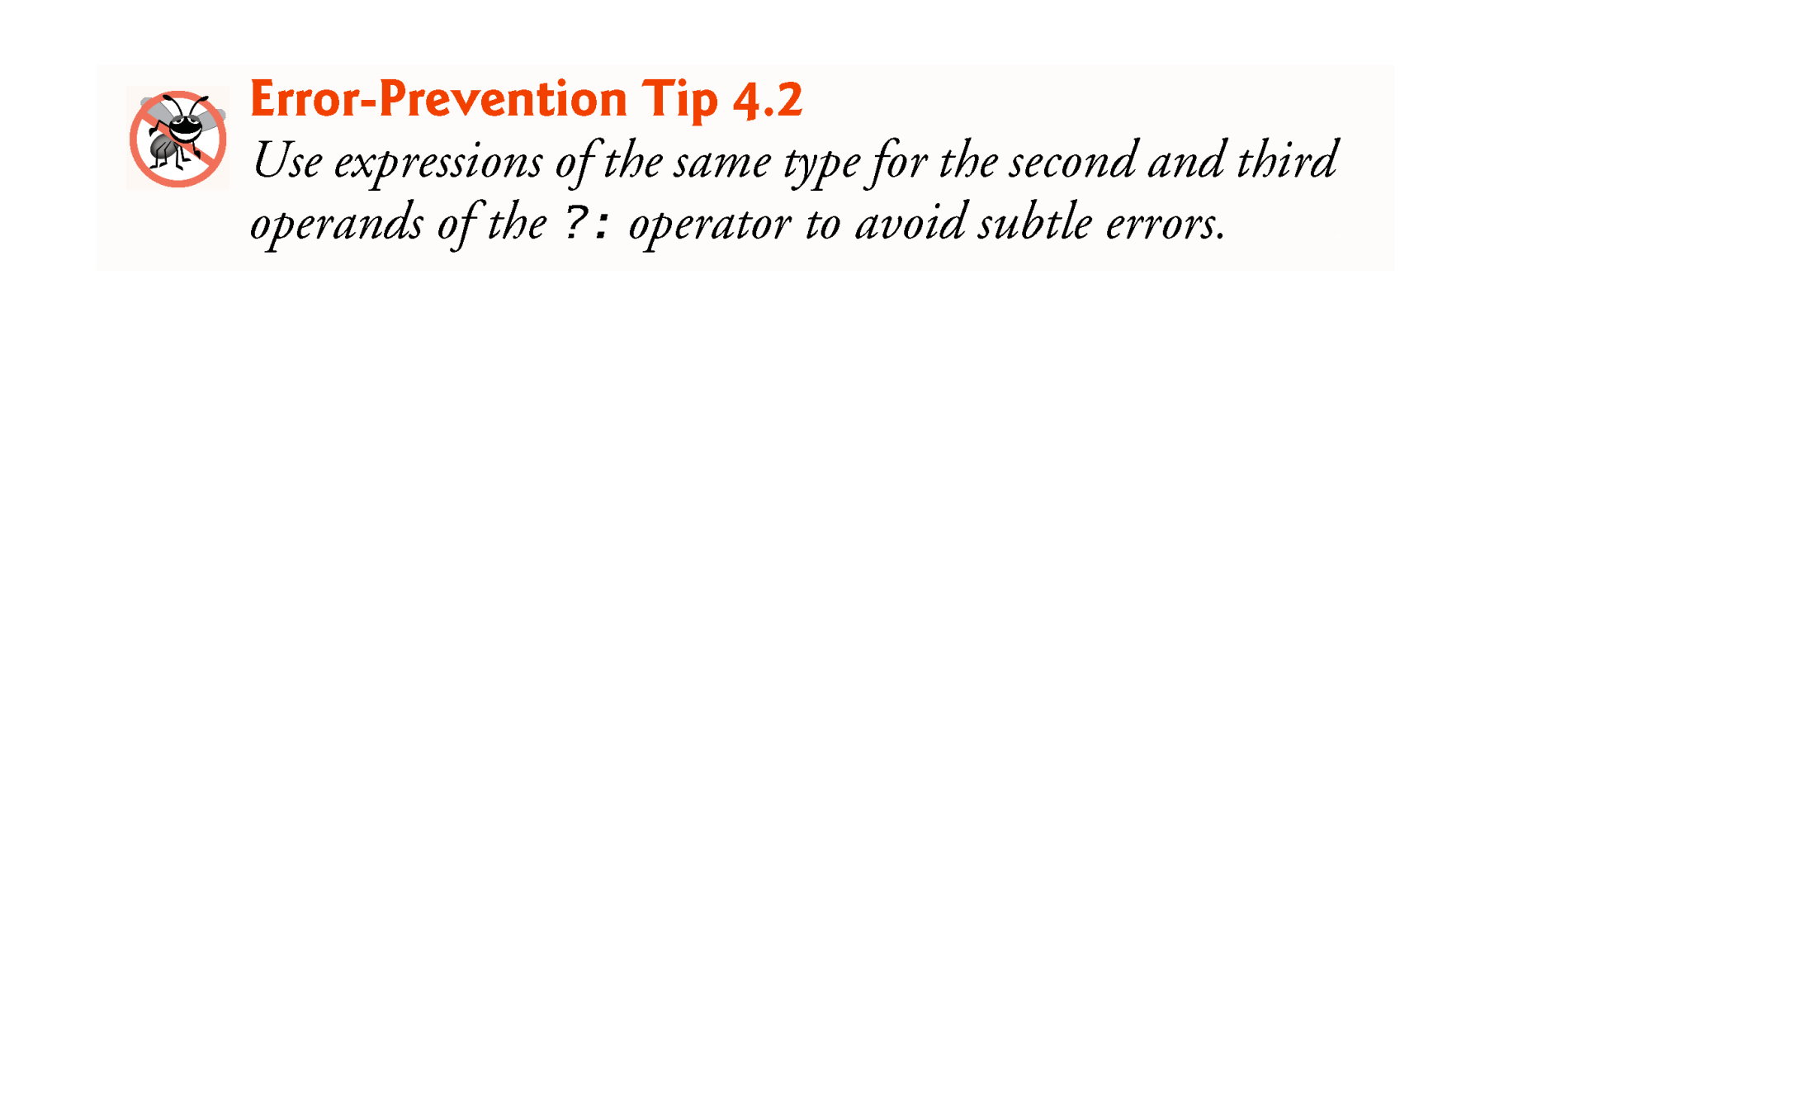

Slide 21
while Repetition Statement
Repetition statement—repeats an action while a condition remains true.
Pseudocode
While there are more items on my shopping list Purchase next item and cross it off my list
The repetition statement’s body may be a single statement or a block.
Eventually, the condition will become false. At this point, the repetition terminates, and the first statement after the repetition statement executes.

Slide 22
while Repetition Statement - Cont
Example of Java’s while repetition statement: find the first power of 3 larger than 100. Assume int variable product is initialized to 3.
while (product <= 100) product = 3 * product;
Each iteration multiplies product by 3, so product takes on the values 9, 27, 81 and 243 successively.
When product becomes 243, product <= 100 becomes false.
Repetition terminates. The final value of product is 243.
Program execution continues with the next statement after the while statement.

Slide 23
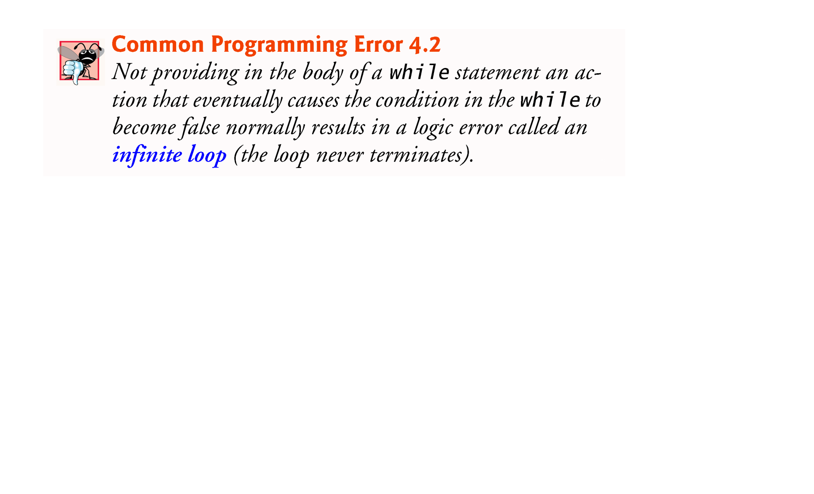

Slide 24
Formulating Algorithms: Counter-Controlled Repetition
A class of ten students took a quiz. The grades (integers in the range 0-100) for this quiz are available to you. Determine the class average on the quiz.
The class average is equal to the sum of the grades divided by the number of students.
The algorithm for solving this problem on a computer must input each grade, keep track of the total of all grades input, perform the averaging calculation and print the result.

Slide 25
Formulating Algorithms: Counter-Controlled Repetition - Cont
Pseudocode Algorithm with Counter-Controlled Repetition
Use counter-controlled repetition to input the grades one at a time.
A variable called a counter (or control variable) controls the number of times a set of statements will execute.
Counter-controlled repetition is often called definite repetition, because the number of repetitions is known before the loop begins executing

Slide 26
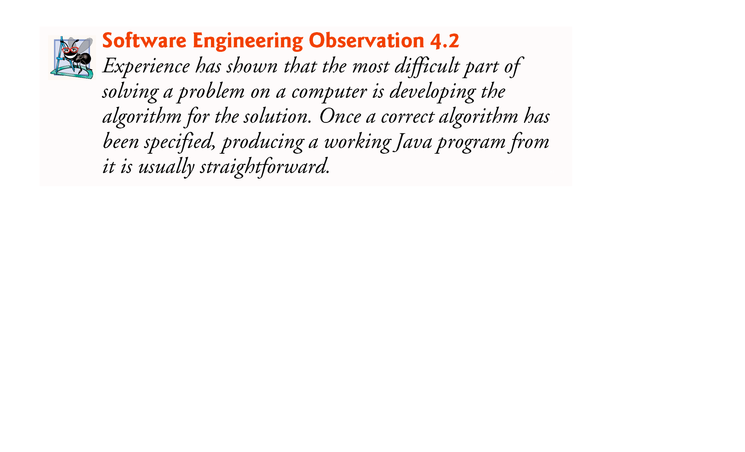

Slide 27
Formulating Algorithms: Counter-Controlled Repetition - Cont
A total is a variable used to accumulate the sum of several values.
A counter is a variable used to count.
Variables used to store totals are normally initialized to zero before being used in a program.

Slide 28
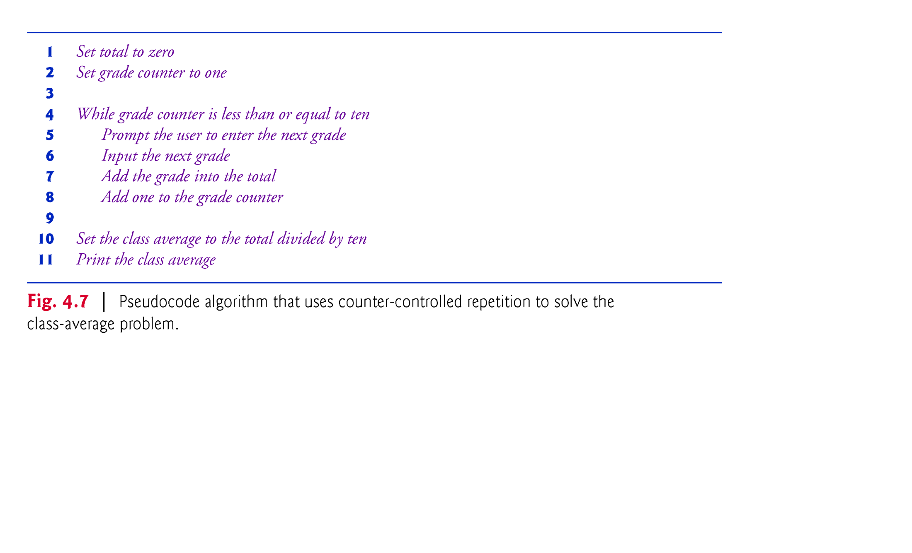

Slide 29
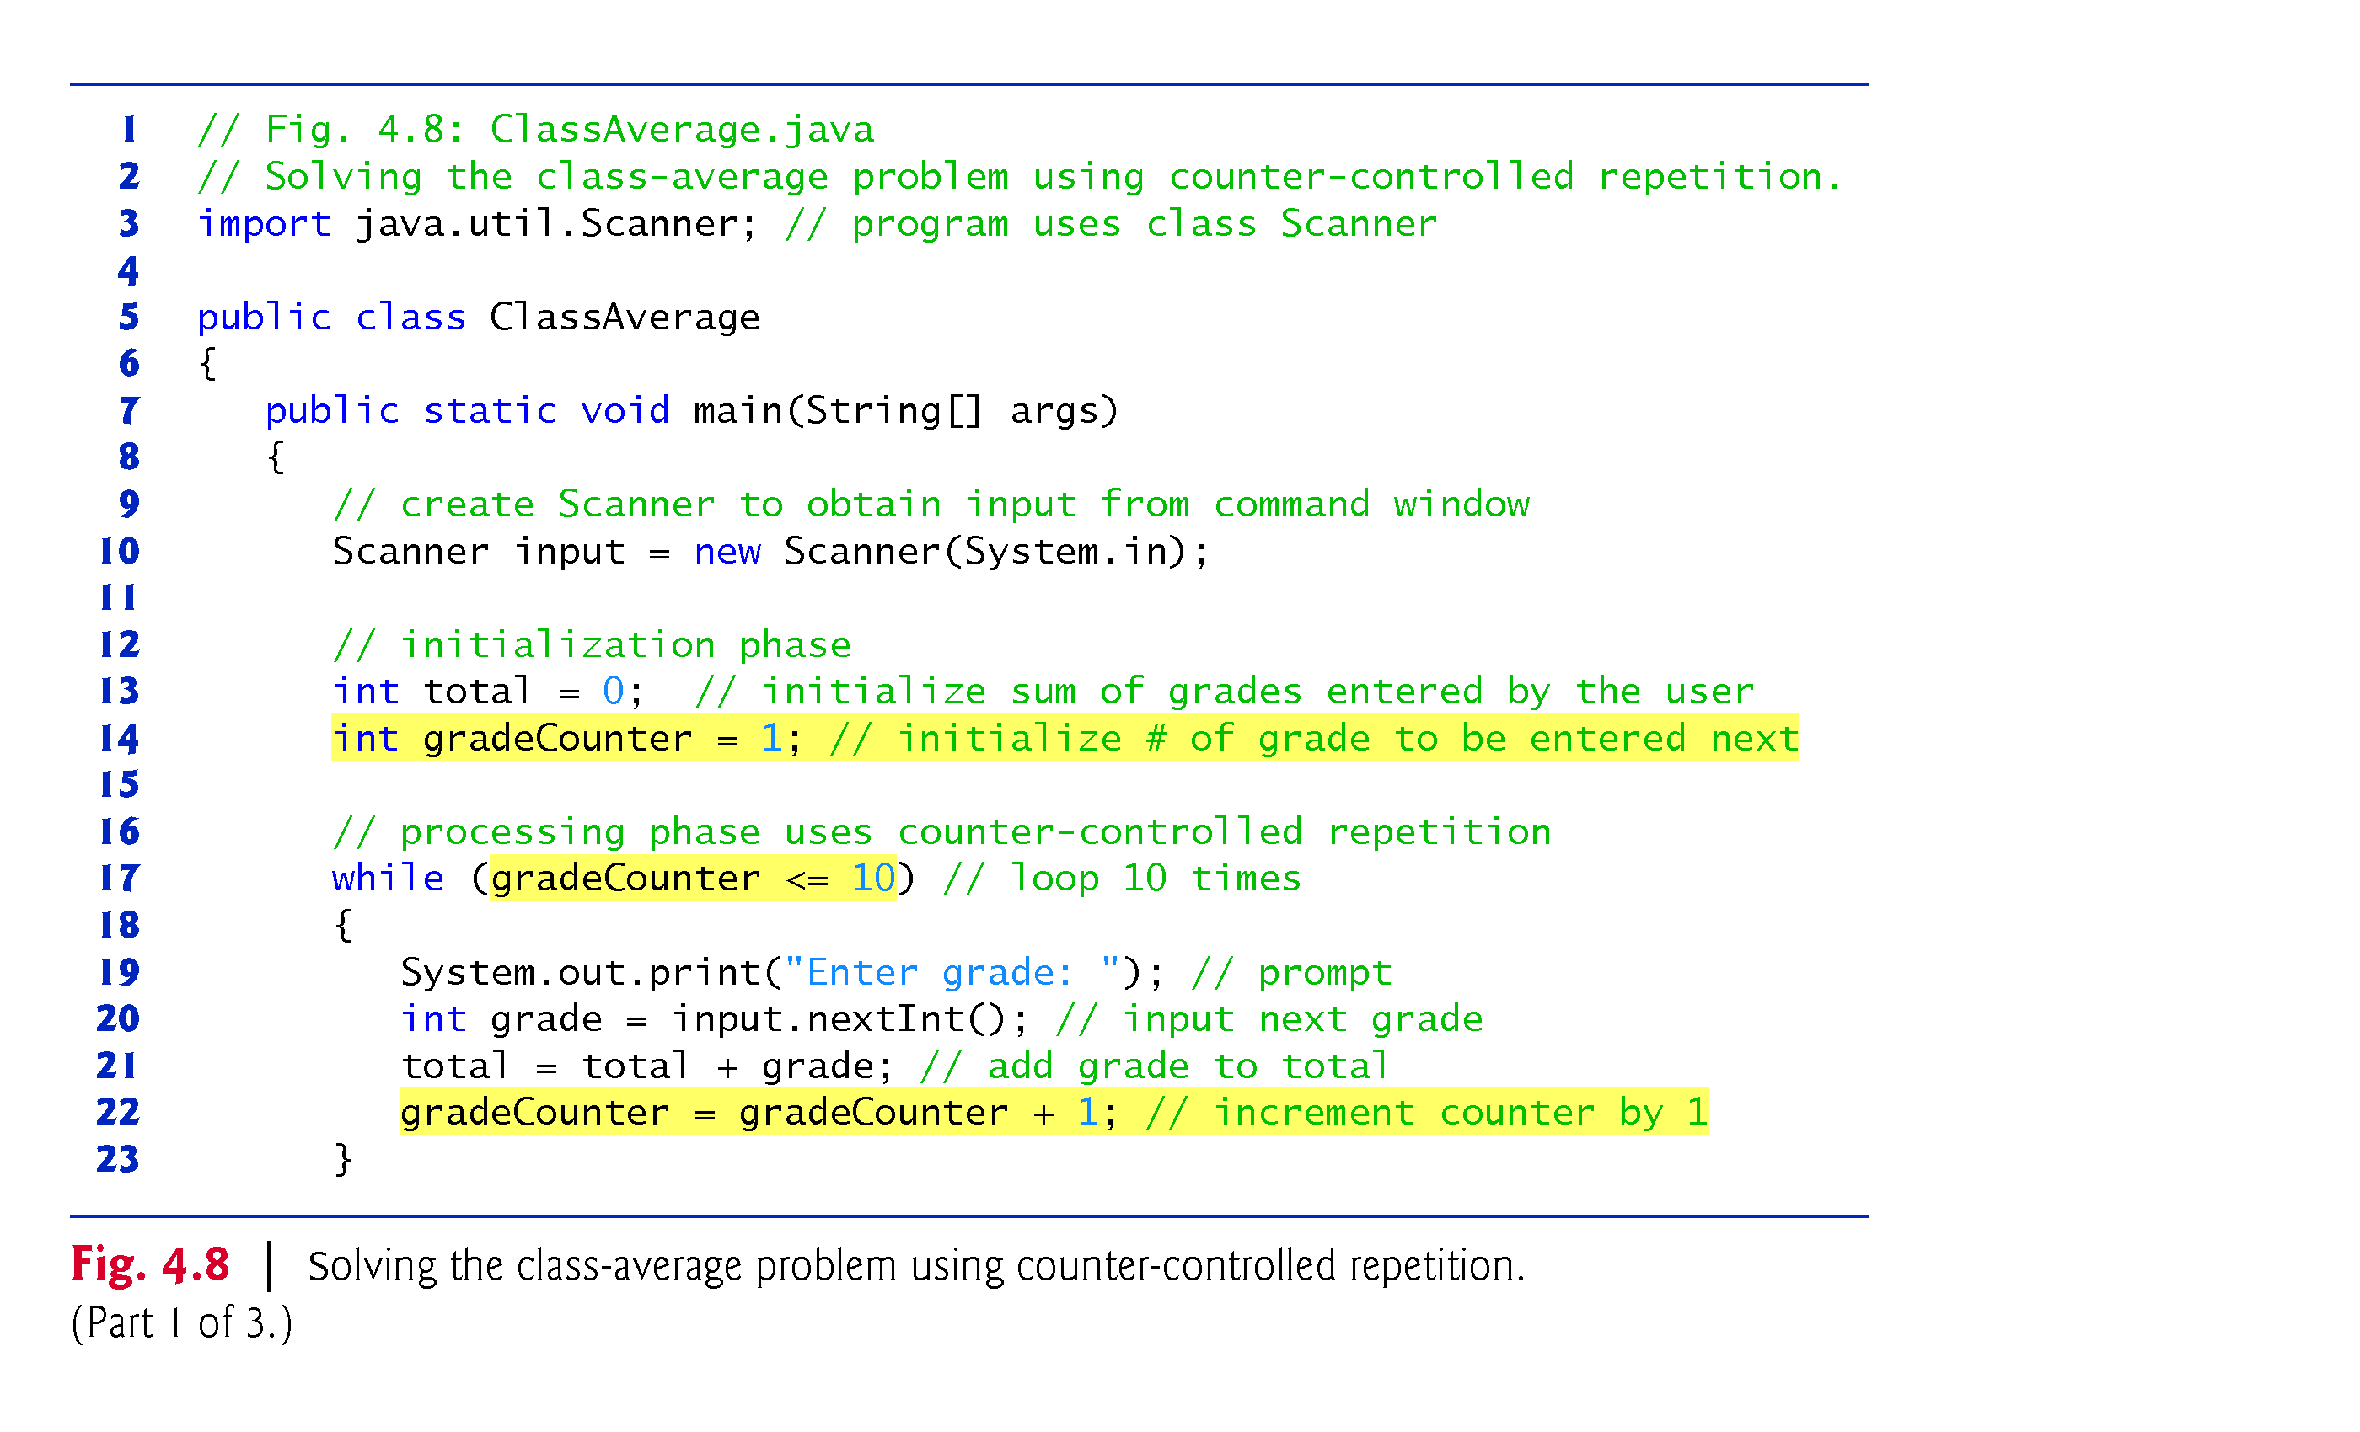

Slide 30
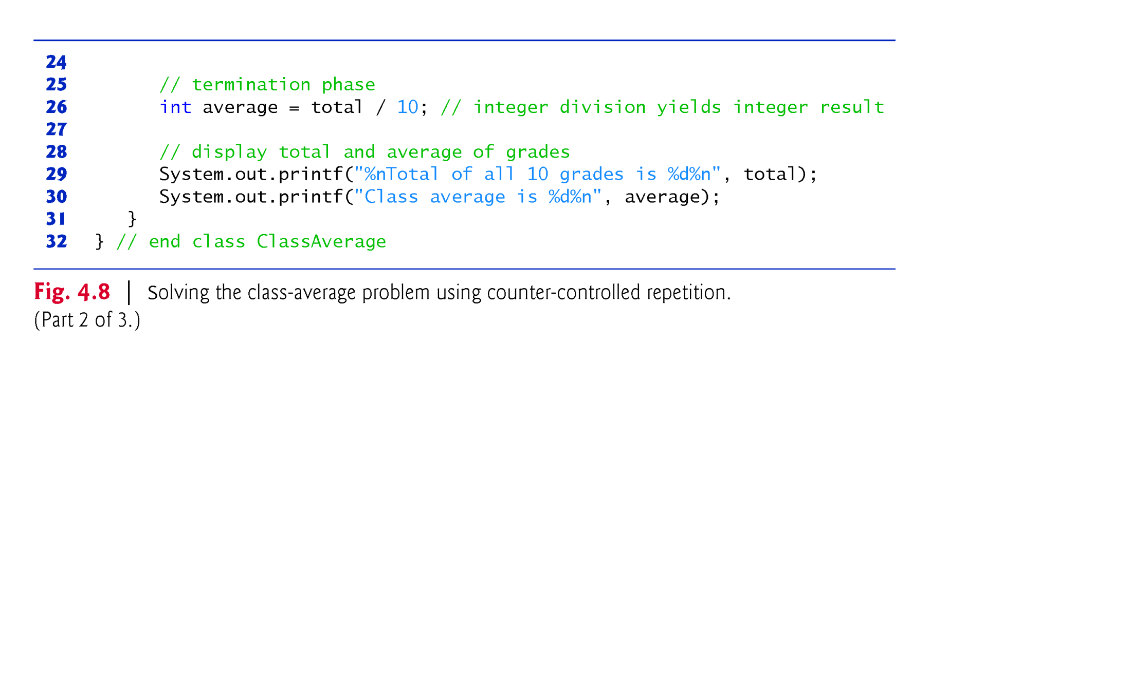

Slide 31
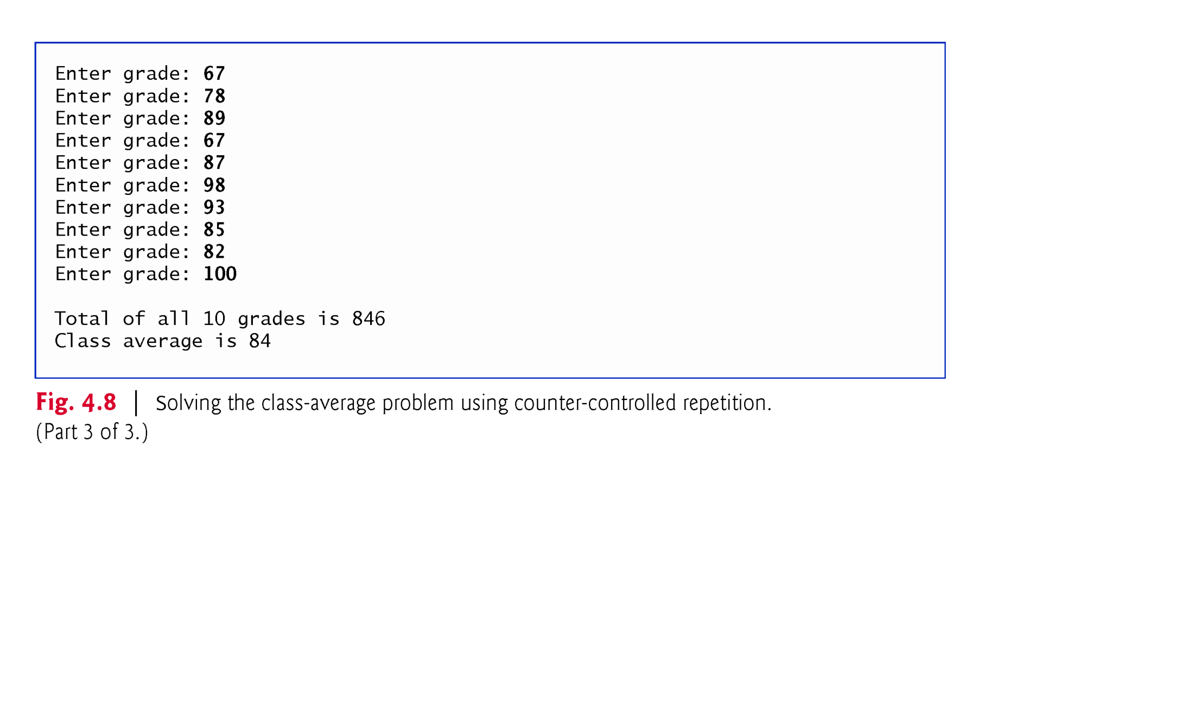

Slide 32
Formulating Algorithms: Counter-Controlled Repetition - Cont
A Deeper Look at Receiving User Input
Any time a program receives input from the user, various problems might occur. For example, in line 20 of Fig. 4.8
int grade = input.nextInt(); // input next grade
we assume that the user will enter an integer grade in the range 0 to 100.
However, the person entering a grade could enter an integer less than 0, an integer greater than 100, an integer outside the range of values that can be stored in an int variable, a number containing a decimal point or a value containing letters or special symbols that’s not even an integer.
Notes:
Note on Defensive Programming

Slide 33
Formulating Algorithms: Counter-Controlled Repetition - Cont
To ensure that inputs are valid, industrial-strength programs must test for all possible erroneous cases.
A program that inputs grades should validate the grades by using range checking to ensure that they are values from 0 to 100.
You can then ask the user to reenter any value that’s out of range.
If a program requires inputs from a specific set of values (e.g., nonsequential product codes), you can ensure that each input matches a value in the set.

Slide 34
Formulating Algorithms: Sentinel-Controlled Repetition
Develop a class-averaging program that processes grades for an arbitrary number of students each time it is run.
Sentinel-controlled repetition is often called indefinite repetition because the number of repetitions is not known before the loop begins executing.
A special value called a sentinel value (also called a signal value, a dummy value or a flag value) can be used to indicate “end of data entry.”
A sentinel value must be chosen that cannot be confused with an acceptable input value.

Slide 35
Formulating Algorithms: Sentinel-Controlled Repetition - Contd
The pseudocode statement
Calculate and print the class average
can be refined as follows:
If the counter is not equal to zero Set the average to the total divided by the counter Print the average else Print “No grades were entered”
Test for the possibility of division by zero—a logic error that, if undetected, would cause the program to fail or produce invalid output.

Slide 36
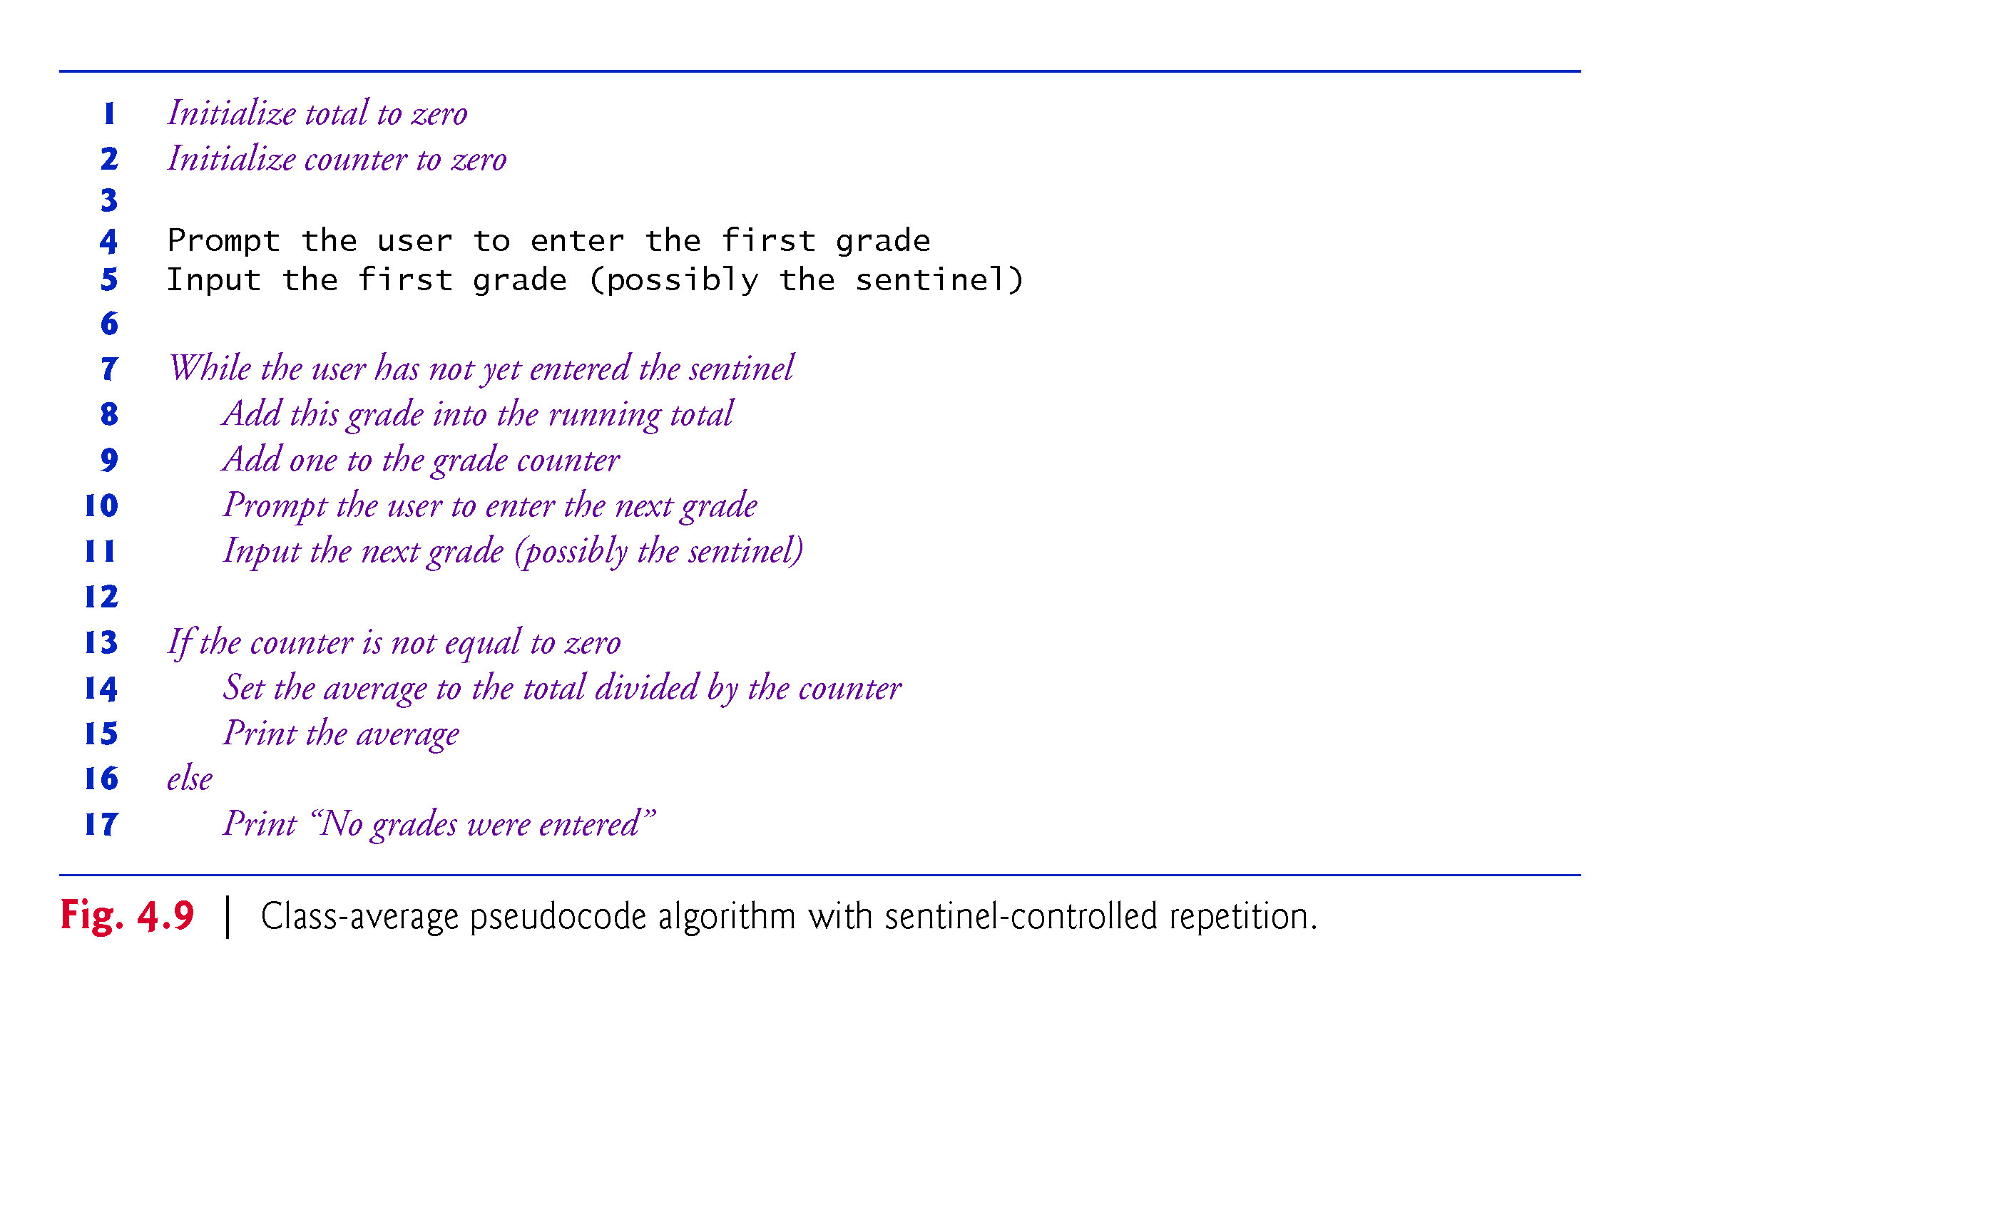

Slide 37
Compound Assignment Operators
Compound assignment operators abbreviate assignment expressions.
Statements like variable = variable operator expression; where operator is one of the binary operators +, -, *, / or % can be written in the form
variable operator= expression;
Example:
c = c + 3;
can be written with the addition compound assignment operator, +=, as
c += 3;
The += operator adds the value of the expression on its right to the value of the variable on its left and stores the result in the variable on the left of the operator.

Slide 38
Increment and Decrement Operators
Unary increment operator, ++, adds one to its operand
Unary decrement operator, --, subtracts one from its operand
An increment or decrement operator that is prefixed to (placed before) a variable is referred to as the prefix increment or prefix decrement operator, respectively.
An increment or decrement operator that is postfixed to (placed after) a variable is referred to as the postfix increment or postfix decrement operator, respectively.

Slide 39
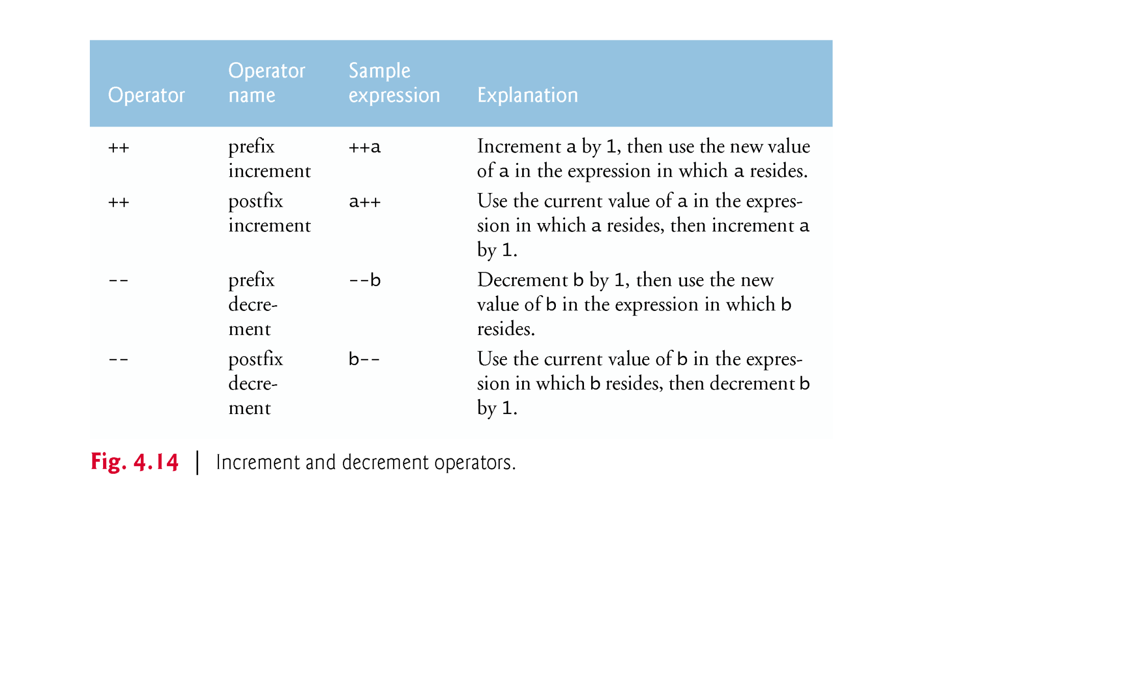

Slide 40
Increment and Decrement Operators (Cont.)
Using the prefix increment (or decrement) operator to add (or subtract) 1 from a variable is known as preincrementing (or predecrementing) the variable.
Preincrementing (or predecrementing) a variable causes the variable to be incremented (decremented) by 1; then the new value is used in the expression in which it appears.
Using the postfix increment (or decrement) operator to add (or subtract) 1 from a variable is known as postincrementing (or postdecrementing) the variable.
This causes the current value of the variable to be used in the expression in which it appears; then the variable’s value is incremented (decremented) by 1.

Slide 41
Questions
State whether each of the following is true or false. If false, explain why.
a) An algorithm is a procedure for solving a problem in terms of the actions to execute and the order in which they execute. b) A set of statements contained within a pair of parentheses is called a block. c) A selection statement specifies that an action is to be repeated while some condition remains true. d) A nested control statement appears in the body of another control statement. e) Java provides the arithmetic compound assignment operators +=, -=, *=, /= and %= for abbreviating assignment expressions

Slide 42
Questions
f) The primitive types (boolean, char, byte, short, int, long, float and double) are portable across only Windows platforms. g) Specifying the order in which statements execute in a program is called program control. i) Instance variables of type boolean are given the value true by default. j) Pseudocode helps you think out a program before attempting to write it in a programming language.

Slide 43
Answers
a) True. b) False. A set of statements contained within a pair of braces ({ and }) is called a block. c) False. A repetition statement specifies that an action is to be repeated while some condition remains true. d) True. e) True. f) False. The primitive types (boolean, char, byte, short, int, long, float and double) are portable across all computer platforms that support Java. g) True. i) False. Instance variables of type boolean are given the value false by default. j) True

